Slide 1
Temporary Small Scale Mining CONTRACT (TSSMC)
PMRB-Benguet TWG
Presentation
April 24, 2018
Ecolodge, Magsaysay Avenue Baguio City

Slide 2
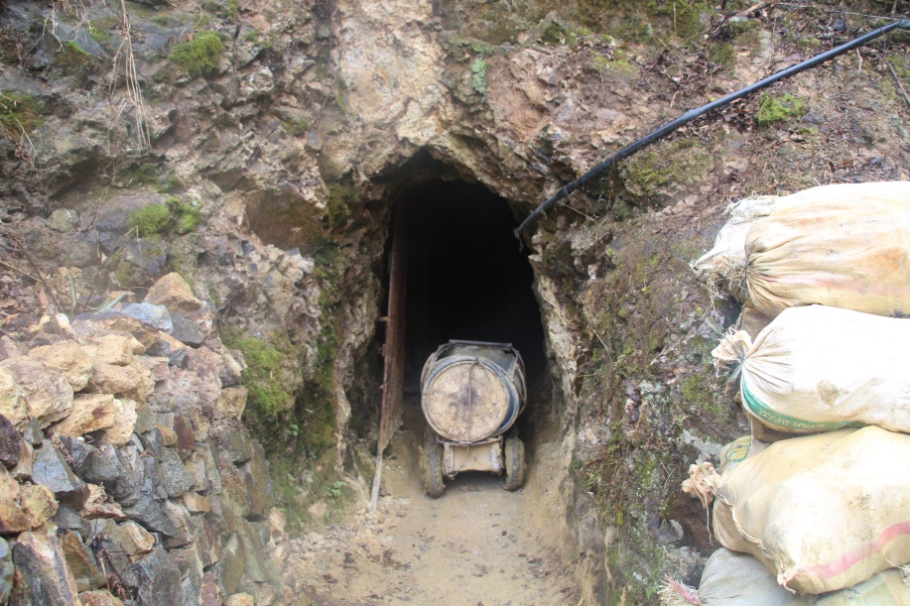
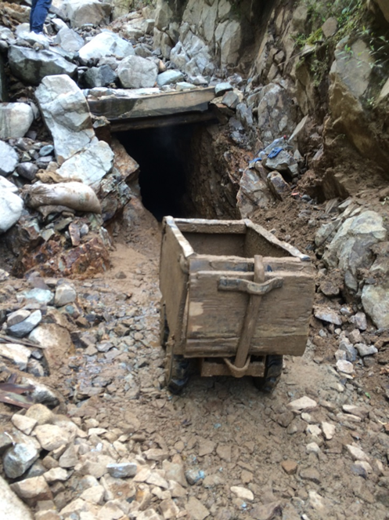
TSSMC Status
TSSMC were awarded to twelve (12) SSM associations by the Governor of Benguet dated October 12, 2014.
Six (6) Months period renewable for like period.
With twelve (12) conditions.

Slide 3
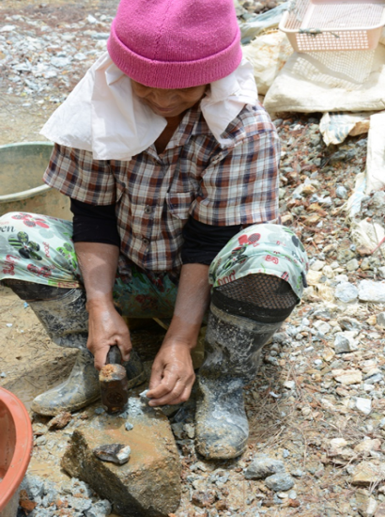
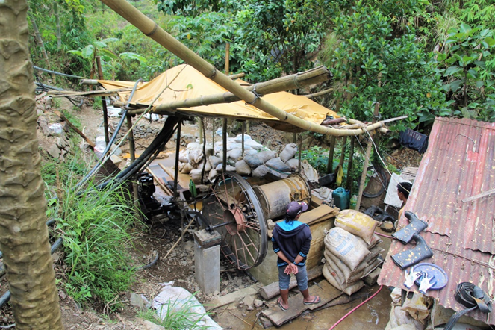
TSSMC Conditions:
Undertake Mining activities in accordance with mining plans duly approved by the Board.
Abide by the SSM Safety Rules and Regulations and allow access for authorized inspection team of the Board to undertake periodic monitoring.
Submit to the Board the required agreement/consent/waiver of the holder of mining rights, owner of ancestral domain/land, where the SSM activities are located

Slide 4
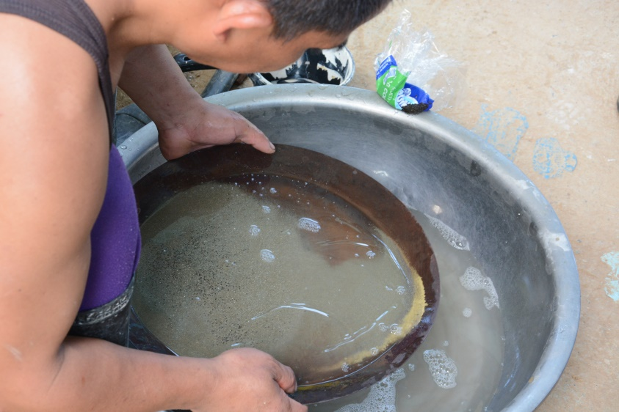
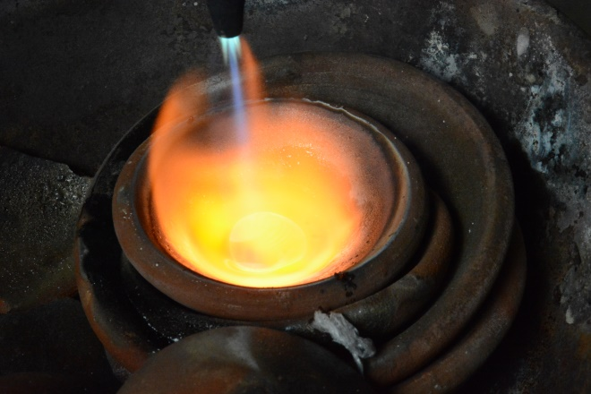
TSSMC ;12 Conditions
Pay all taxes and fees, and others as maybe provided by law.
Comply with pertinent laws, policies rules and regulations on environmental protection and conservation(e.g. Tree cutting, pollution control, mineral processing , use of toxic chemicals.
File under oath at the end of each quarter a detailed production and financial report to the Board.

Slide 5
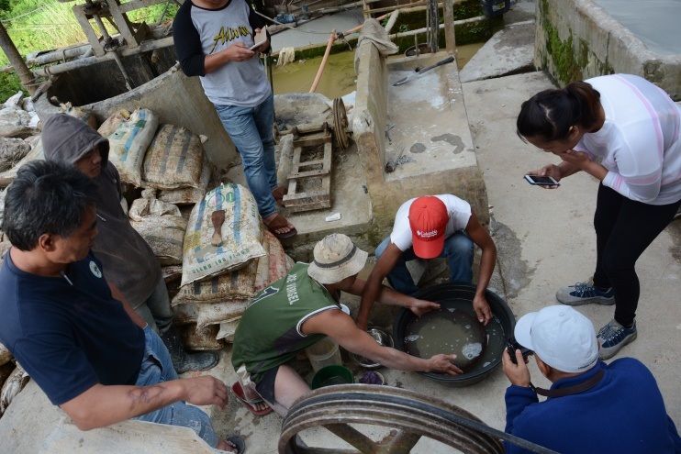
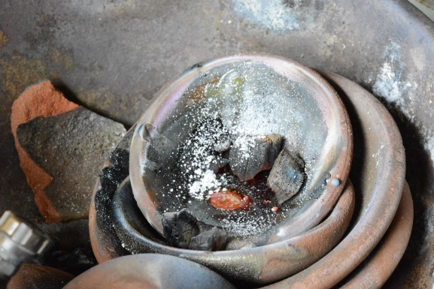
TSSMC ;12 Conditions
Assume responsibility of the registration with the Board of all its members as miners and ensure their safety at all times while working on the mines.
Agree to the establishment of common, safe and efficient custom mills to process minerals or ore-bearing materials and tailings storage facilities which shall be limited within the contract area upon approval of the Board.
Undertake mining activities only within the metes and bounds of the area approved by the Board for the Contractor as described hereunder.
(Site plan and technical description of the area applied for, including the mining plan, both approved by the Board shall be form part of the TSSMC).

Slide 6
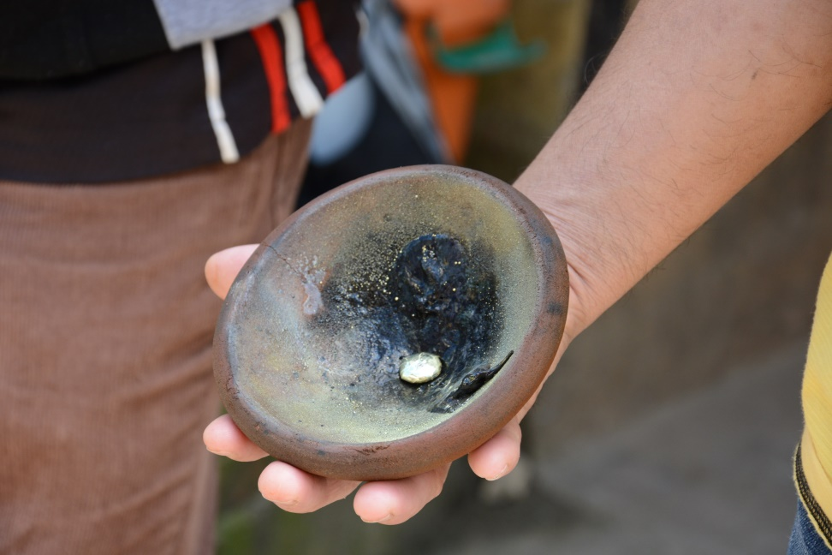

TSSMC ;12 Conditions
10. That the Contractor during the pendency of this Contract must endeavour to pursue his application for the declaration as Minahang Bayan.
11. This Contract is non-transferable.
12. This TSSMC awarded to the Contractor maybe suspended/rescinded/cancelled for violations of any of the herein stipulated conditions upon due notice and hearing by the Board.

Slide 7
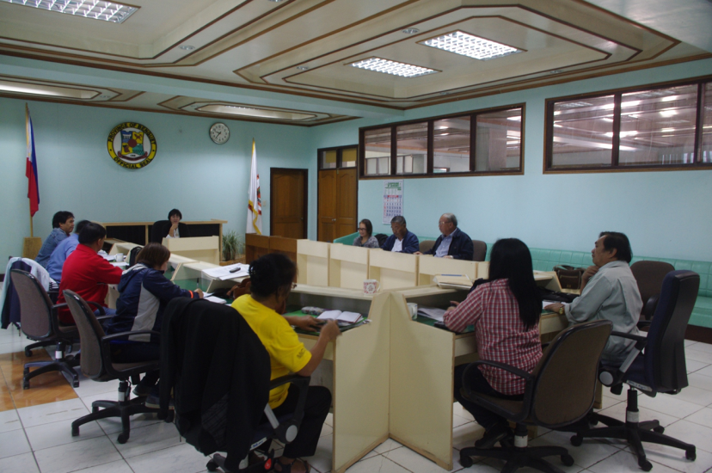
TSSMC Update;
PMRB 1st Quarter Regular meeting on January 21, 2016 at the Session Hall La Trinidad Benguet;
Board agreed to renew the TSSMC previously issued until such time that their area is declared as MB provided that they will strictly comply with the submission of production report, SHES requirements and terms and conditions of the contract.

Slide 8
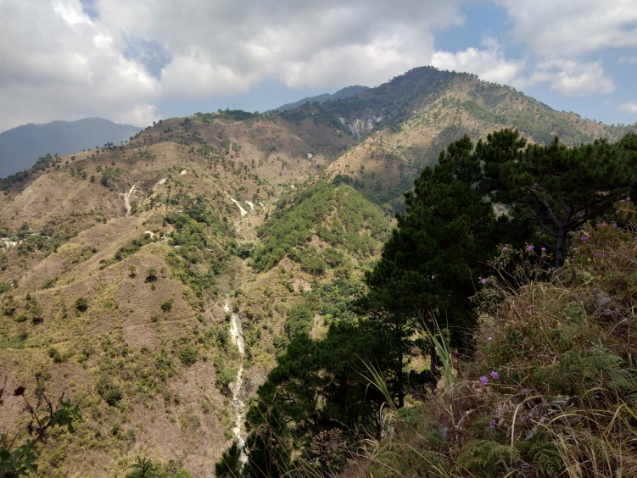
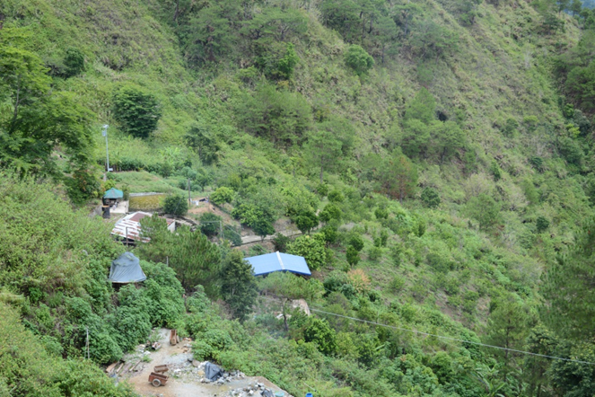
12 SSM Associations with TSSMC
Association | Permittee | Location
1. Juan Carlos S. Milan SSMGroup | Juan Carlos Milan | Virac, Itogon
2. Jose Carlo M. Milan SSMGroup | Jose Carlo Milan | Virac, Itogon
3. William Butch SSMAI | Edgar Sacpa | Dalicno ,Ampucao, Itogon
4. Billy Ayadi | Billy Ayadi | Ampucao. Itogon
5. Yanggold Tocmo Binatangan Pocket Miners Association, Inc. | Gina Abanga | Tuding, Itogon
6. RINO Pocket Mining Association | Gol Bumacas | Tocmo, Loacan, Itogon
7. Goldstream Pocket Miners Association | David Tomilas | Camp 4, Tuba
8. Camp Six Explorer’s SSMA | Matthew Daping | Camp 6, Tuba
9. Goldstar Pocket Miners Association | Clarita Subido | Bakun
10. Lower Suyoc Taneg Pocket Miners | Johnny Antonio | Taneg, Mankayan
11. Jesson Cervantes | Jesson Cervantes | Taneg, Mankayan
12. Bayudang-Magging Clan SSPMA | Charlie Madino/Mundo Andoy | Taneg &Suyoc Mankayan

Slide 9
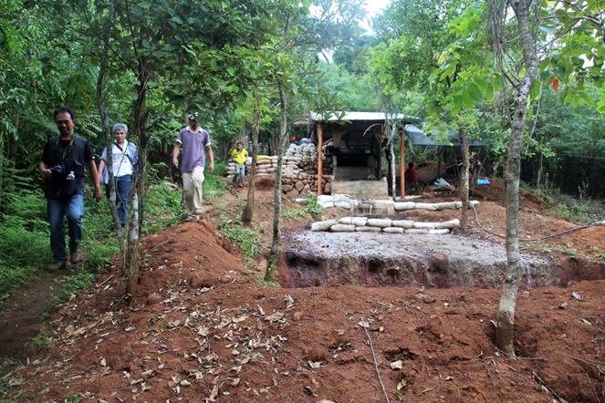
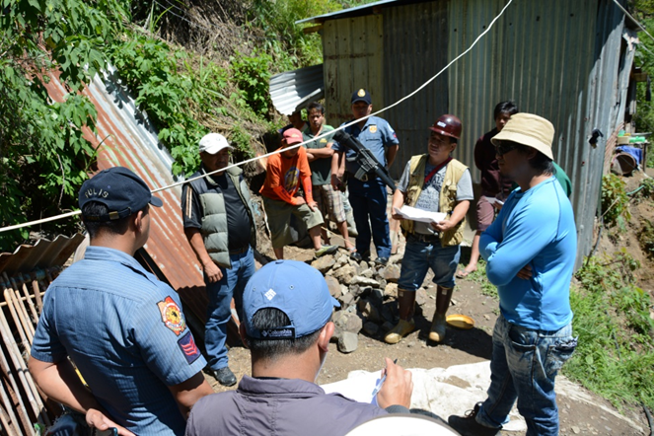
Way Forward…..
SSM Contract Mandatory requirements;

Slide 10
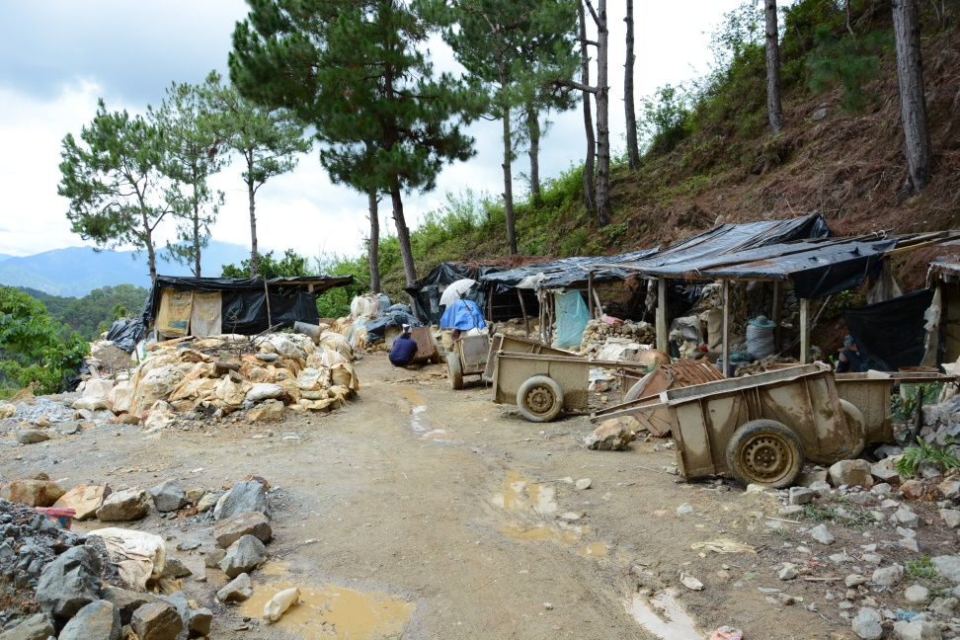
Section 10. Application to Enter Into a Small-Scale Mining Contract
Minahang Bayan application mandatory requirements in five (5) copies:
a. Duly accomplished and notarized application form (Annex B);
b. Application fee of PhPIO,OOO.00 for non-metallic minerals and PhP20,000.OO for gold, silver and/or chromite, payable to the Regional Office concerned;
c. Copy of small-scale miners license;

Slide 11
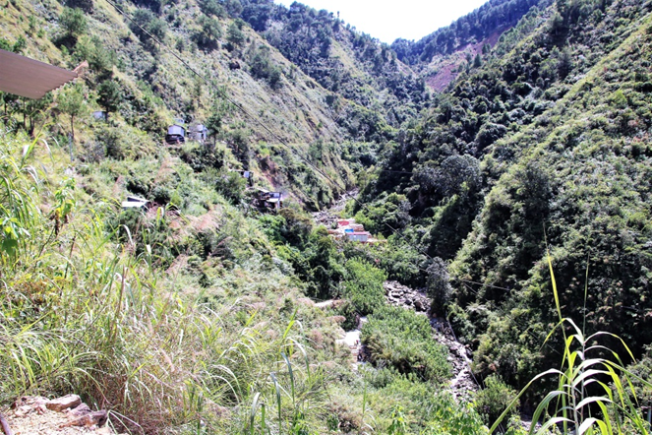
Section 10. Application to Enter Into a Small-Scale Mining Contract
d. Location map of the proposed small-scale mining contract area showing its geographic coordinates/meridional block(s) and boundaries in relation to the Minahang Bayan, major environmental features and other projects using a National Mapping and Resources Information Authority (NAMRIA) topographic map in a scale of or 1: 10,000 duly prepared, signed and sealed by a deputized Geodetic Engineer;
e. Sketch plan of the proposed small-scale mining contract area at a convenient scale duly prepared, signed and sealed by a deputized Geodetic Engineer;
f. Proposed small-scale mining contract;

Slide 12
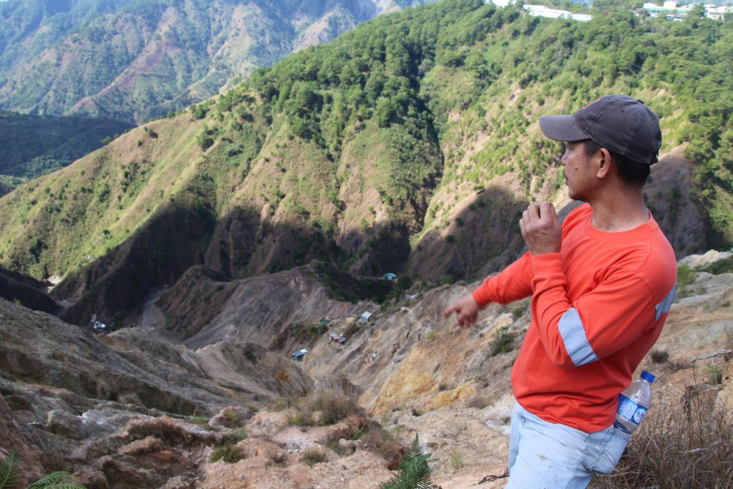
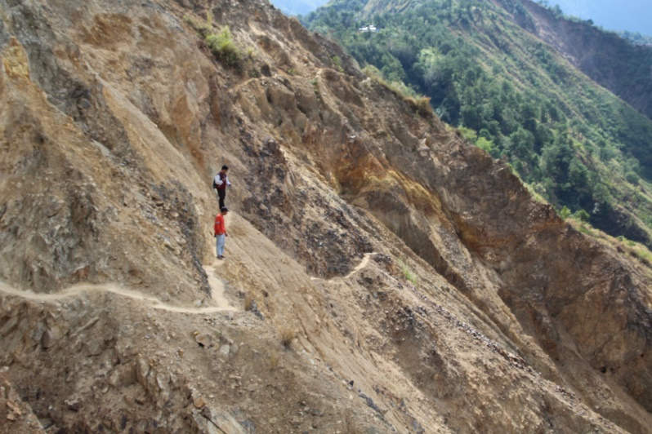
Section 10. Application to Enter Into a Small-Scale Mining Contract
g. Application for survey order;
h. Proposed Two-year Work Program (Annex C);
PEIMP;
j. CEMCRR or Certificate of Exemption, in lieu of a CEMCRR, if the applicant has neither past nor present mineral resource use or mining-related venture(s);

Slide 13
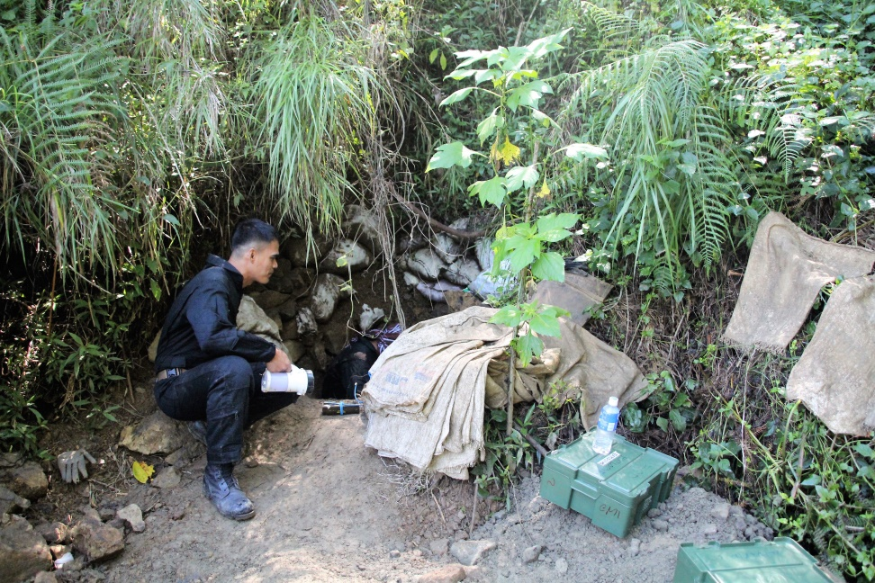
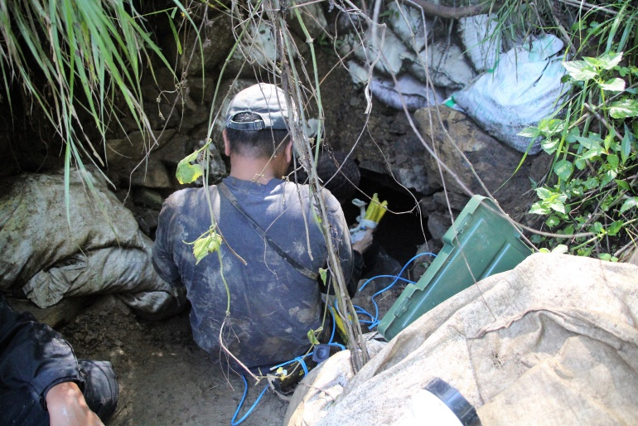
Section 10. Application to Enter Into a Small-Scale Mining Contract
k. COMP; ASHP; and
m. Sworn declaration of the total area (hectarage) covered by the applicant's/ small scale mining contract(s)/application(s) in the entire country.
Applications with incomplete mandatory' requirements shall not be accepted. Within fifteen (15) days upon receipt of the application, the Board shall check through the control map if the area is free from conflict. In case the applied area is in conflict totally, the Board shall deny the application. In case the applied area is partially in conflict, the Board shall return the application for revision and resubmission within fifteen (15) days: Provided, That only one (1) people's small-scale mining contract may be awarded at any one time to a small-scale mining contractor in the entire country'.

